Slide 1
Killaloe Diocesan Pastoral Council

Slide 2
Pope Francis – on Pastoral Councils
“How needed pastoral councils are! A bishop cannot guide a diocese without pastoral councils. A parish priest cannot guide the parish without the parish council. This is fundamental!”

Slide 3
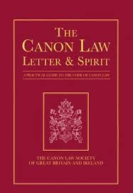
Code of Canon Law – on Pastoral Councils
In each diocese, in so far as pastoral circumstances suggest, a pastoral council is to be established. Its function, under the authority of the Bishop, is to study and weigh those matters which concern the pastoral works in the diocese, and to propose practical conclusions concerning them.”
Can. #511

Slide 4
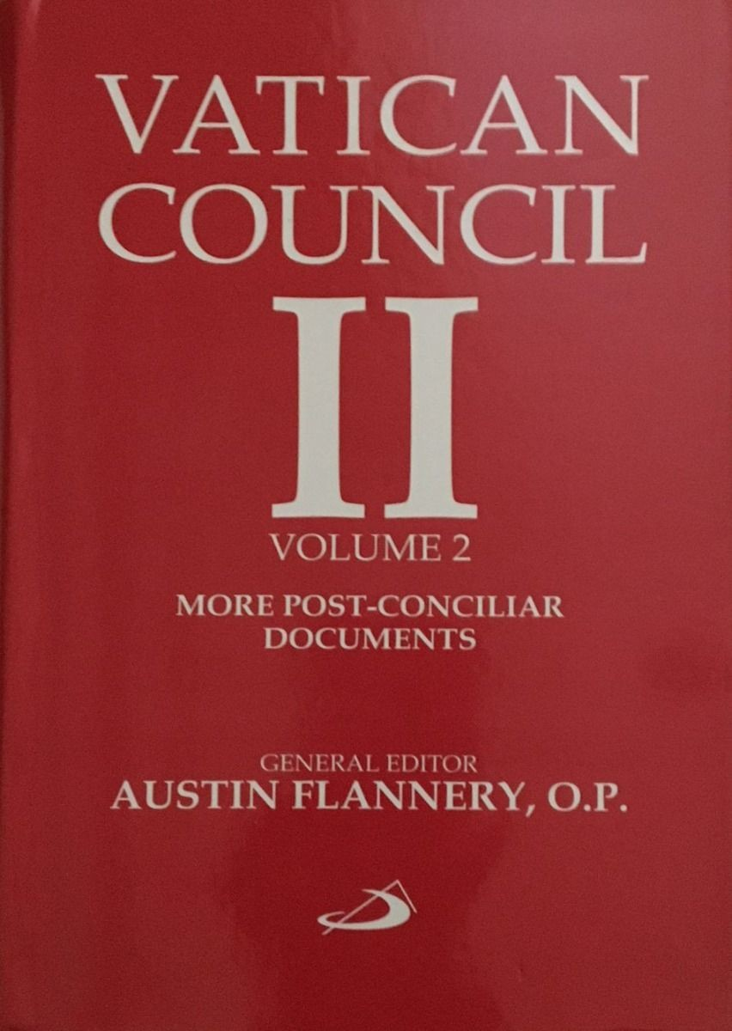
Christus Dominus – on Pastoral Councils
“It is highly desirable that in every diocese a special pastoral council be established, presided over by the diocesan bishop himself, in which clergy, religious, and laity specially chosen for the purpose will participate. It will be the function of this council to investigate and consider matters relating to pastoral activity, and to formulate practical conclusions regarding them.”
CD #27

Slide 5
Pope John Paul II - Christifideles Laici
“in a diocesan level this structure [the Diocesan Pastoral Council] could be the principal form of collaboration, dialogue, and discernment... The participation of the lay faithful in these Councils can broaden resources in consultation and the principle of collaboration – and in certain instances also in decision-making – if applied in a broad and determined manner.”
CL #25

Slide 6
Synodal Church
In being a synodal church the people of God are centrally involved in discerning where and how the Spirit is calling and leading the Church at this time.
Killaloe DPC Constitution

Slide 7
Function of the Diocesan Pastoral Council
It is a consultative body that works with the bishop in exploring and developing pastoral initiatives in the diocese.

Slide 8
The Diocesan Pastoral Council is concerned with:
Concern itself with the pastoral works of the diocese
Collaborate with the bishop in formulating recommendations for the developing and supporting the diocesan pastoral vision.

Slide 9
Diocesan Pastoral Council collaborates with:
Council of Priests,
Office for Mission and Ministry
Pastoral Area Councils
Parish Pastoral Councils
Other Councils or groups set up by the diocese for specific pastoral needs

Slide 10
Annual Review with the Office for Mission and Ministry
Will engage with the Office of Mission and Ministry in an annual review of the Diocesan Pastoral Plan and recommend any necessary revisions to the Bishop.

Slide 11
Boundaries
The Diocesan Pastoral Council will have structured links with all Diocesan bodies; however, it is not within its remit to direct their activities.

Slide 12
Membership of the Diocesan Pastoral Council
The members of Christ’s faithful assigned to the pastoral council are to be selected in such a way that the council truly reflects the entire portion of the people of God which constitutes the diocese taking account of the different regions of the diocese, of social conditions and professions, and of the part played in the apostolate by the members, whether individually or in association with other.
Can #512 §2

Slide 13
The make-up of the group
Bishop
Council of Priests 2 Representatives
Ministers of Pastoral Care and Catechesis 2 Representatives
Pastoral Areas 1 Representative each
Diocesan Communication Officer
Vicar/Director for Mission and Ministry
The Bishop/DPC can also co-opt people from specific areas of ministry or with particular skillsets.

Slide 14
Traits we will try to exercise at our meetings.
Committed to our faith
Prayer
Good listening
Good communicating
Positive attitude
Open to study, reflection and discernment.
Pastoral sensitivity to the needs of parishes and the diocese
Willing to commit to the time required.

Slide 15
Meetings
At least four meetings a year
Topics will be submitted in good time.
Delegation and sub-groups
Work in collaboration with the Council of Priests
Special Meetings

Slide 16
Office of Mission and Ministry
The Office for Mission and Ministry and the Diocesan Pastoral Council, will operate as custodians of the Diocesan Pastoral Plan.
The Office for Mission and Ministry will report to the Diocesan Pastoral Council at each meeting

Slide 17
Finance
A budget for the Diocesan Pastoral Council shall be presented to the Financial Controller on a yearly basis.
This Photo by Unknown Author is licensed under CC BY-SA

Slide 18
AMENDMENTS TO THE DIOCESAN PASTORAL COUNCIL CONSTITUTION
With the approval of the Bishop amendments to the Constitution of the Diocesan Pastoral Council may be proposed and adopted at any regular Diocesan Pastoral Council meeting.

Slide 19
Things for us to keep an eye on…
1. Welcome.
How do we as a diocese create welcoming environments in all aspects of what we do?
2. Worship.
Liturgy & Prayer
3. Witness.
Community Life – disciples inviting others into discipleship.
4. Catechesis/Education & Formation/Training.
5. Mission
Outreach & Evangelisation.

